Slide 1


Quiz 2: RNN
For today’s review session, kindly clone the GitHub repository
https://github.com/aim-msds/msds-2025ft-ml3-review
Then follow the setup procedures.
Machine Learning 3
Session 11
MSDS FT 2025
09 May 2025

Slide 2
Session 11 and 12
Gameplan
9:10 AM to 9:30 AM Quiz 2
9:30 AM to 10:00 AM Quiz 2 Discussion
10:00 AM to 10:10 AM Recent AI News
10:10 AM to 10:30 AM Midterm Review Part 1
10:30 AM to 11:00 AM Break
11:00 AM to 12:30 PM Midterm Review Part 2
Notes:
Header has to end with a colon, and the body has to be indented

Slide 3
Quiz 2: RNN
General Instructions
Multiple Choice
13 questions
20 minutes
Quiz opens at 9:10 AM (Friday, May 9, 2025)
Open notes (student notes, slides, reference books, Python notebooks), closed internet, closed LLMs
Notes:
Header has to end with a colon, and the body has to be indented

Slide 4
Answers to Questions

Slide 5
1 GPU Utilization
What are factors that can significantly bottleneck GPU utilization when not tuned properly during neural network training or inference? Check all that apply
Improper batch size
Using softmax instead of ReLU
Insufficient CPU allocated for data loading
Too few or too many training epochs
Notes:
Header has to end with a colon, and the body has to be indented

Slide 6
1 GPU Utilization
What are factors that can significantly bottleneck GPU utilization when not tuned properly during neural network training or inference? Check all that apply
Improper batch size
Using softmax instead of ReLU
Insufficient CPU allocated for data loading
Too few or too many training epochs
Notes:
Header has to end with a colon, and the body has to be indented

Slide 7
2 RNNs
What is the primary features that distinguishes RNNs from basic feedforward neural networks?
They have convolutional layers
They are used for predicting sequential data, where patterns can “recur”
They have connections that loop back on themselves
They make use of multi-head attention
Notes:
Header has to end with a colon, and the body has to be indented

Slide 8
2 RNNs
What is the primary features that distinguishes RNNs from basic feedforward neural networks?
They have convolutional layers
They are used for predicting sequential data, where patterns can “recur”
They have connections that loop back on themselves
They make use of multi-head attention
Notes:
Header has to end with a colon, and the body has to be indented

Slide 9
3 Long-term Dependencies
What mechanism is typically used to capture long-term dependencies for RNNs?
Pooling layers
Gated mechanisms like in LSTM or GRU
Fully connected layers
Passing the previous time step’s output to the next time step
Notes:
Header has to end with a colon, and the body has to be indented

Slide 10
3 Long-term Dependencies
What mechanism is typically used to capture long-term dependencies for RNNs?
Pooling layers
Gated mechanisms like in LSTM or GRU
Fully connected layers
Passing the previous time step’s output to the next time step
Notes:
Header has to end with a colon, and the body has to be indented

Slide 11
4 RNN Variants
Which of the following are variants of RNNs? Check all that apply
Long sequence time model (LSTM)
Long short-term memory (LSTM)
GPU reliant units (GRU)
Gated recurrent unit (GRU)
Notes:
Header has to end with a colon, and the body has to be indented

Slide 12
4 RNN Variants
Which of the following are variants of RNNs? Check all that apply
Long sequence time model (LSTM)
Long short-term memory (LSTM)
GPU reliant units (GRU)
Gated recurrent unit (GRU)
Notes:
Header has to end with a colon, and the body has to be indented

Slide 13
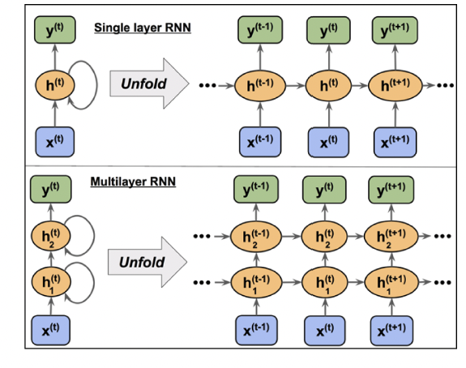
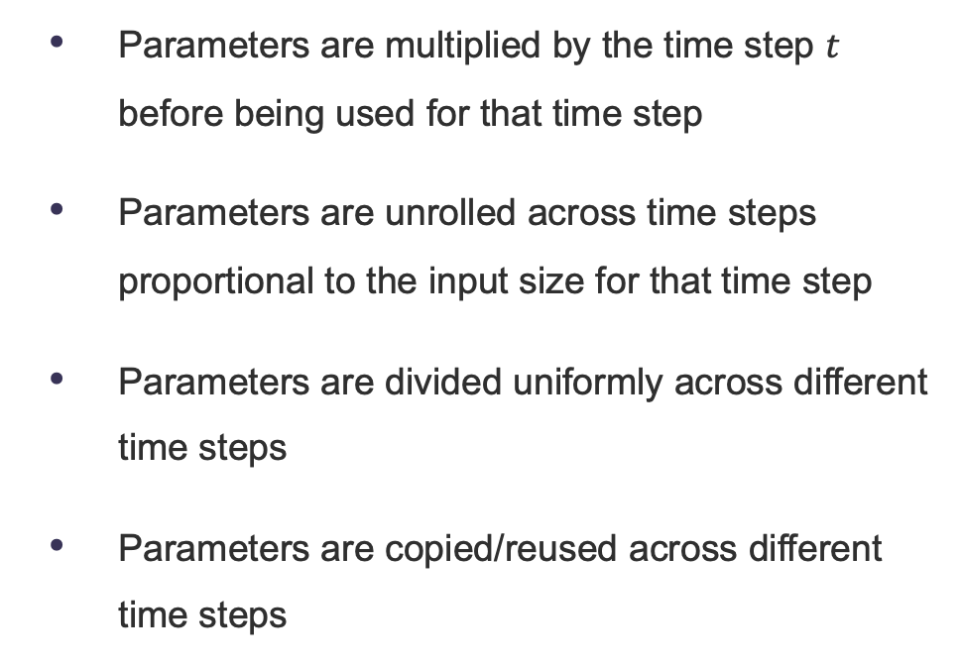
5 Unfolding
When unfolding, what happens to the parameters (e.g. weights and biases)?
Parameters are multiplied by the time step $t$ before being used for that time step
Parameters are unrolled across time steps proportional to the input size for that time step
Parameters are divided uniformly across different time steps
Parameters are copied/reused across different time steps
Notes:
Header has to end with a colon, and the body has to be indented

Slide 14
5 Unfolding
When unfolding, what happens to the parameters (e.g. weights and biases)?
Parameters are multiplied by the time step $t$ before being used for that time step
Parameters are unrolled across time steps proportional to the input size for that time step
Parameters are divided uniformly across different time steps
Parameters are copied/reused across different time steps
Notes:
Header has to end with a colon, and the body has to be indented

Slide 15
6 Vanishing and Exploding Gradients
What causes vanishing and exploding gradients in RNNs?
Accumulation of very large or very small gradient updates of chain rule on long sequences
Vanishing gradients are caused by large activation functions, while exploding gradients are caused by small activation functions.
Vanishing gradients are caused by improper weight initialization, while exploding gradients are caused by using LSTM or GRU cells
When you try to predict given a long lookback window
Notes:
Header has to end with a colon, and the body has to be indented

Slide 16
6 Vanishing and Exploding Gradients
What causes vanishing and exploding gradients in RNNs?
Accumulation of very large or very small gradient updates of chain rule on long sequences
Vanishing gradients are caused by large activation functions, while exploding gradients are caused by small activation functions.
Vanishing gradients are caused by improper weight initialization, while exploding gradients are caused by using LSTM or GRU cells
When you try to predict given a long lookback window
Notes:
Header has to end with a colon, and the body has to be indented

Slide 17
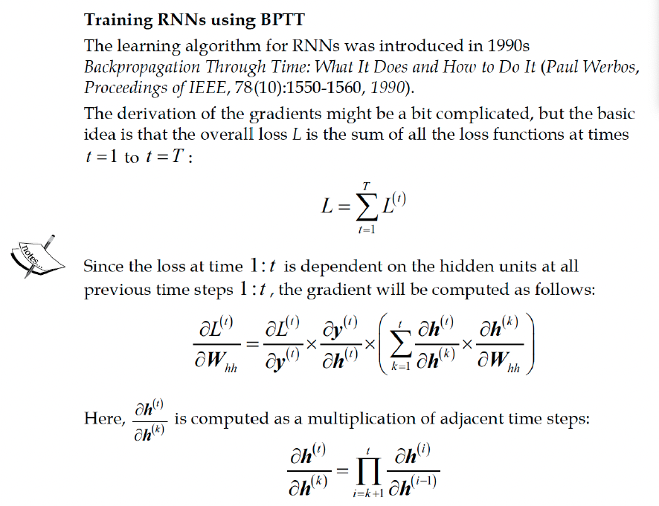
6 Vanishing and Exploding Gradients
What causes vanishing and exploding gradients in RNNs?
Accumulation of very large or very small gradient updates of chain rule on long sequences
Notes:
Header has to end with a colon, and the body has to be indented

Slide 18
7 Gates
Which of the following is NOT a gate used in RNNs?
Input gate
Activation gate
Forget gate
Output gate
Notes:
Header has to end with a colon, and the body has to be indented

Slide 19
7 Gates
Which of the following is NOT a gate used in RNNs?
Input gate
Activation gate
Forget gate
Output gate
Notes:
Header has to end with a colon, and the body has to be indented

Slide 20
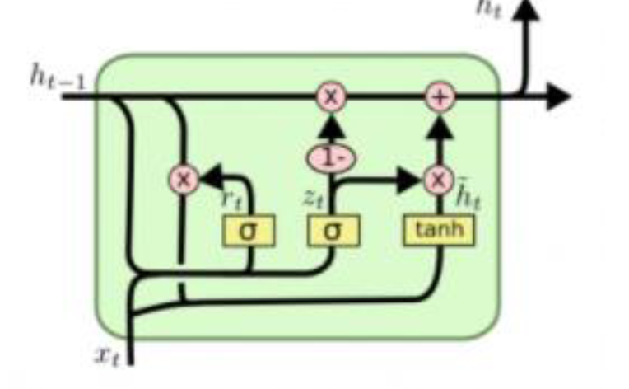
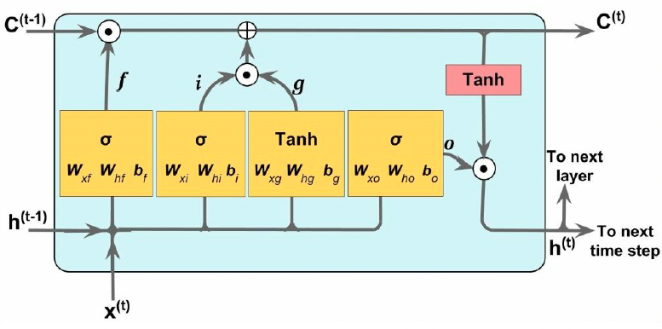
7 Gates
Which of the following is NOT a gate used in RNNs?
LSTM
GRU
Notes:
Header has to end with a colon, and the body has to be indented

Slide 21
8 LSTM
In LSTM cells, what is the purpose of the input gate?
To control which parts of the cell state should be updated with new information from the current input pair.
To determine which parts of the previous cell state should be forgotten
To regulate the output of the LSTM cell and its contribution to the next layer.
To add the input to the cell state and set hidden state to zero.
Notes:
Header has to end with a colon, and the body has to be indented

Slide 22
8 LSTM
In LSTM cells, what is the purpose of the input gate?
To control which parts of the cell state should be updated with new information from the current input pair.
To determine which parts of the previous cell state should be forgotten
To regulate the output of the LSTM cell and its contribution to the next layer.
To add the input to the cell state and set hidden state to zero.
Notes:
Header has to end with a colon, and the body has to be indented

Slide 23
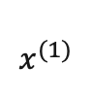
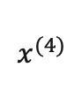
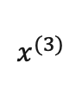
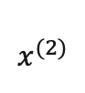
8 LSTM
LSTM Architecture
carry track
RNN
RNN
RNN
RNN
$$x^{(1)}$$
$$x^{(2)}$$
$$x^{(3)}$$
$$x^{(4)}$$

Slide 24
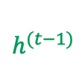

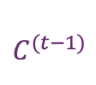
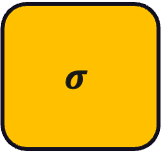
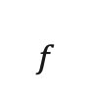
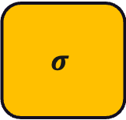
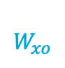
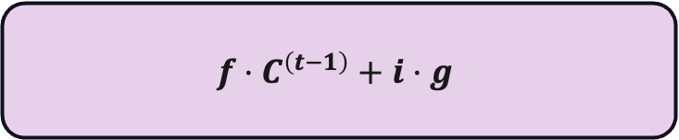
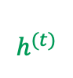

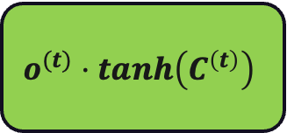
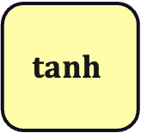
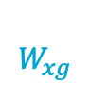
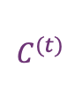
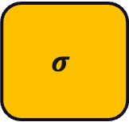

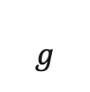
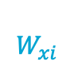
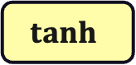
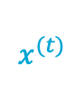
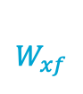

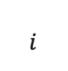
8 LSTM
LSTM Architecture
update carry track
$$C^{(t−1)}$$
$$C^{(t)}$$
$$f⋅C^{\left(t−1\right)}+i⋅g$$
$$f$$
$$i$$
$$g$$
$$tanh$$
$$h^{(t−1)}$$
$$W_{hf}$$
$$W_{hi}$$
$$W_{hg}$$
$$W_{ho}$$
$$h^{(t)}$$
$$σ$$
$$σ$$
$$tanh$$
$$σ$$
$$o^{(t)}⋅tanh\left(C^{\left(t\right)}\right)$$
update hidden state
$$W_{xf}$$
$$W_{xi}$$
$$W_{xg}$$
$$W_{xo}$$
$$x^{(t)}$$

Slide 25
9 Challenges of RNNs
What is a key challenge faced by RNNs and their variants?
Inability to perform classification
Inability to handle large datasets
Inability to capture long-term dependencies
Inability to model time series
Notes:
Header has to end with a colon, and the body has to be indented

Slide 26
9 Challenges of RNNs
What is a key challenge faced by RNNs and their variants?
Inability to perform classification
Inability to handle large datasets
Inability to capture long-term dependencies
Inability to model time series
Notes:
Header has to end with a colon, and the body has to be indented

Slide 27
10 Gradient Clipping
Why might one choose to use gradient clipping in the training of RNNs?
To improve convergence speed by accelerating the gradient descent process
To ensure that gradients do not become too small, which can mitigate the vanishing gradient problem
To prevent gradients from becoming too large and causing numerical instability, which can lead to exploding gradients
To simplify the gradient calculation process by reducing the complexity of the loss function
Notes:
Header has to end with a colon, and the body has to be indented

Slide 28
10 Gradient Clipping
Why might one choose to use gradient clipping in the training of RNNs?
To improve convergence speed by accelerating the gradient descent process
To ensure that gradients do not become too small, which can mitigate the vanishing gradient problem
To prevent gradients from becoming too large and causing numerical instability, which can lead to exploding gradients
To simplify the gradient calculation process by reducing the complexity of the loss function
Notes:
Header has to end with a colon, and the body has to be indented

Slide 29
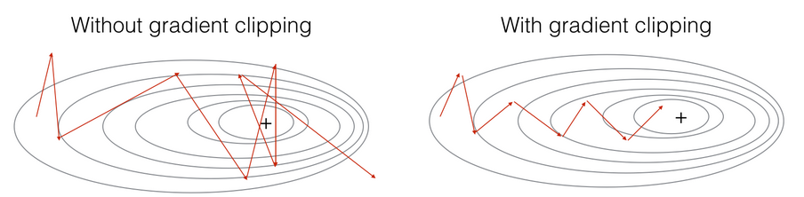
10 Gradient Clipping
Gradient Clipping Illustration
https://deepai.org/machine-learning-glossary-and-terms/gradient-clipping
Notes:
Header has to end with a colon, and the body has to be indented

Slide 30
11 RNN Activation Functions
What types of activation functions are specifically used in the gate mechanisms of LSTMs and GRUs? Check all that apply.
Sigmoid
Softmax
ReLU
Tanh
Notes:
Header has to end with a colon, and the body has to be indented

Slide 31
11 RNN Activation Functions
What types of activation functions are specifically used in the gate mechanisms of LSTMs and GRUs? Check all that apply.
Sigmoid
Softmax
ReLU
Tanh
Notes:
Header has to end with a colon, and the body has to be indented

Slide 32
12 RNN Applications
What types of applications can RNNs be used in? Check all that apply.
Time Series
Natural Language Processing
Weather Forecasting
Classification
Notes:
Header has to end with a colon, and the body has to be indented

Slide 33
12 RNN Applications
What types of applications can RNNs be used in? Check all that apply.
Time Series
Natural Language Processing
Weather Forecasting
Classification
Notes:
Header has to end with a colon, and the body has to be indented

Slide 34
13 Embeddings
What is the primary purpose of embeddings in machine learning models?
To embed data for improved model convergence and stability
To perform dimensionality reduction on numerical features by applying linear transformations
To convert text data into binary format for efficient processing
To transform high-dimensional categorical data like text into lower-dimensional continuous vectors that capture semantic relationships
Notes:
Header has to end with a colon, and the body has to be indented

Slide 35
13 Embeddings
What is the primary purpose of embeddings in machine learning models?
To embed data for improved model convergence and stability
To perform dimensionality reduction on numerical features by applying linear transformations
To convert text data into binary format for efficient processing
To transform high-dimensional categorical data like text into lower-dimensional continuous vectors that capture semantic relationships
Notes:
Header has to end with a colon, and the body has to be indented

Slide 36
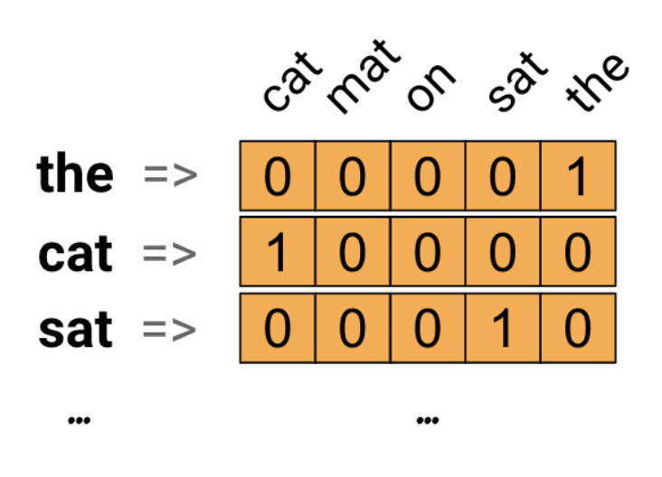
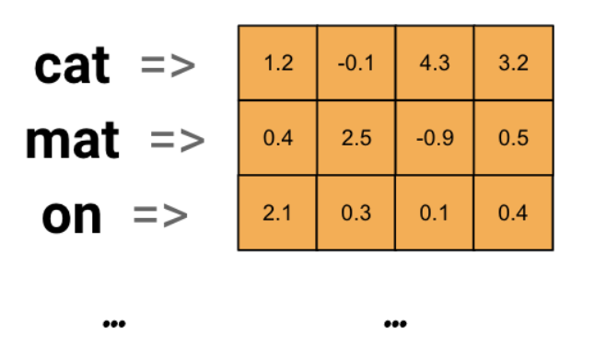
13 Embeddings
Representing text as numbers
Input text: “the cat sat on the mat”
One-hot encoding
Integer encoding
Word embeddings
mapping = {
“cat”: 1, “mat”: 2, “on”: 3, “sat”: 4, “the”: 5
}
input_text = [5, 1, 4, 3, 5, 2]
https://www.tensorflow.org/text/guide/word_embeddings
Notes:
Word embeddings give us a way to use an efficient, dense representation in which similar words have a similar encoding

Slide 37
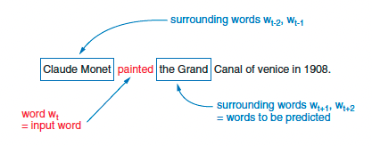
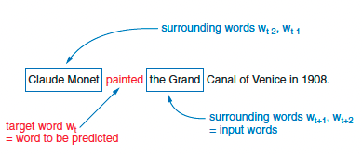
13 Embeddings
Word Embeddings
Queen
Skip-Gram
King
Woman
Man
CBOW
Natural Language Processing in Action by Lane et al.
Notes:
Header has to end with a colon, and the body has to be indented

Slide 38
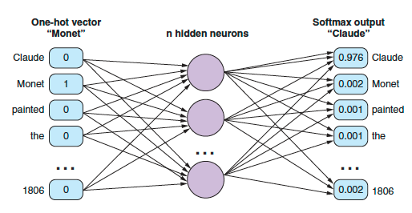
13 Embeddings
Word Embeddings
Natural Language Processing in Action by Lane et al.
Notes:
Header has to end with a colon, and the body has to be indented

